Slide 1
Vehicle System Challenge Collaboration Work Breakdown Proposal
E.R. Griffor - NIST
10August2018

Slide 2
ABS
BMS
MCU
VCU
Trustworthiness federate
Reference Models
CAN
Safety
Security
Resilience
Reliability
Privacy
DB Query/Response
Database
Assessment Algorithms
Star Rating
Safety
Security
Resilience
Reliability
Privacy

Slide 3
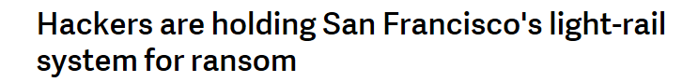
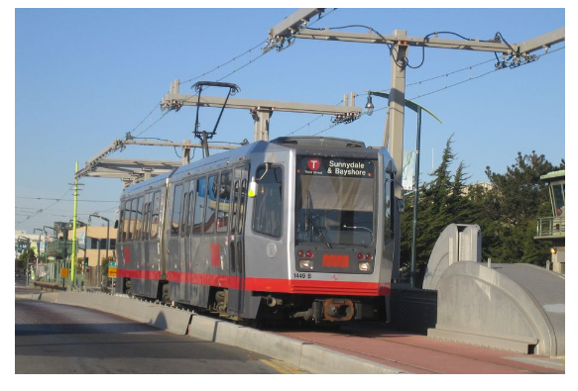
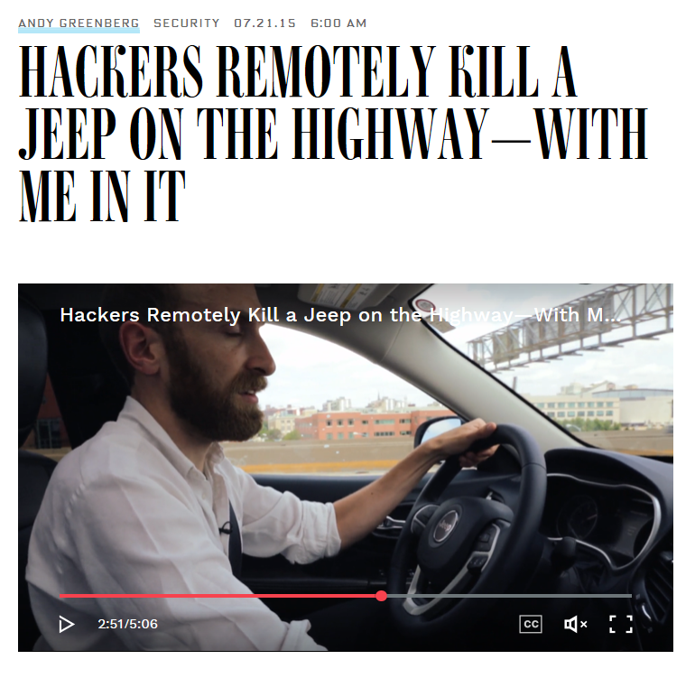



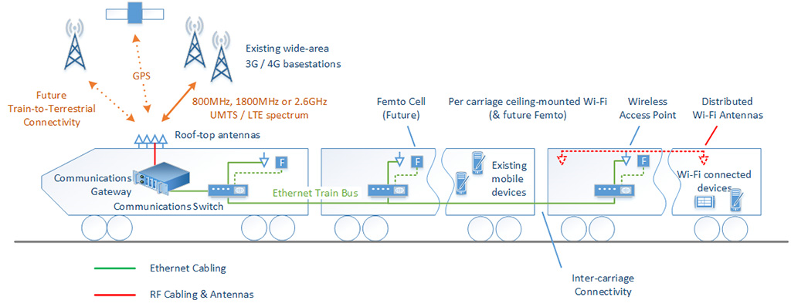
What’s the problem? Increasing levels of communication and automation come with increased risk of nefarious manipulation and less driver understanding of the system
Notable Automotive Hacks to date:
2013: Toyota Prius.
2015: Chrysler Jeep.
2015: Tesla Model S.
2016: Nissan Leaf
2016: The Mitsubishi Outlander
Communication links within and without vehicle can be a point of ingress
Systems being put in place to reduce impact and threat analogous to FMEA & BS26262
Control approach of key sub-systems ‘fail to function?’
Assurance of supply chain?
BUSINESS
RISK

Slide 4
Collaboration Benefits/Tasks
Benefits
Ignite provides for high fidelity modeling of vehicle component functions with multi-physics
UCEF-based co-simulation complements IGNITE capabilities: it is a systems integration tool, targeting general IoT system, enabling interactions across CPS/IoT domains
Tasks
Ricardo provides simplified models in pseudocode and CAN message details
NIST implements initial java federation, scenarios, threats, and analysis
NIST commits to developing a FMU Wrapper that will enable the ‘federation’ of UCEF with IGNITE exported FMUs (this will allow IGNITE FMUs to be brought into UCEF IoT co-simulations as ‘federates’)
(Q3 FY19) Ricardo team provides FMUs for individual components suitable for integration into UCEF simulation and that can substitute for any java federate

Slide 5
A system in changing environments needs to be able to judge the trustworthiness of data to make itself and the wider system resilient
Data is either generated within a system or communicated to it.
The mechatronic system acts on that data
Human beings inside the system are a part of the process and can impart to the system or are affected by it
The situational the system is acting in then defines how much risk is associated with the activity
The fundamental question asked by the system of the data is “Given my situation how much do I trust the data?”
The need is to be resilient to poor data
Situation
Human
Mechatronic
RISK
Data
Comms

Slide 6
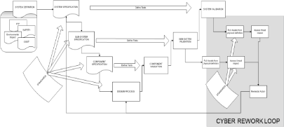



The process being developed allows trustworthiness to be measured → enabling operational risk management and better future system design
Obligation
Threat
THREATS
‘Delivering trust through best in class cyber solutions’
People
Data/Comms.
2018
Q2:2018 Launch of ‘TEST & FIX’
Mitigation
Function
IMPACTS
Use Cases
VULNERABILITIES
Design
Cyber-Physical
System
Understand risk and requirements
Determine level in product and corporate system
Manage
Guidelines &
Standards
Company policy
Trustworthiness
Managed Risk
E.g.:
SAE J3061
ISO/SAE AWI 21434
NCSC Cyber Security Essentials
CPNI Key Principles of Cyber Security for CAV
NIST Cyber Security Framework
Risk
Liability
2019
Legislation
GDPR
NIS Directive

Slide 7
AV Challenge Setup
Develop a UCEF-based co-simulation infrastructure whose components comprise:
(AV Sub-System) The components of a simple and extensible AV system
(Fed Manager) A component that orchestrates the simulation
(Log) A component that captures and stores all component interactions
Run drive cycle scenarios over this infrastructure, where participants either play the role of:
(Defender) A defender actor that may modify controls and messaging to defend system performance of these scenarios
(Disruptor/Attacker) A disruptor actor that attempts to prevent the system’s successful execution of these scenarios
(5-Star Assessment) Analyze the Log of a simulation run and provide a ‘trustworthiness score’

Slide 8
Decision/Collaboration Roles and Timeline
CAN Messages and
Behavior Pseudo-Code
Level 1
Federation
(Java)
Level 2
Federation
(IGNITE FMUs)
Level 3
Federation
(HIL)
Java Federates
UCEF Federation
Requires
Addendum to
Agreement
Requires
Collaborative
Agreement
Ricardo
Khalid
Khalid
Ricardo
(NIST?)
Ricardo
University
Etc.
(NIST?)
NIST
(Suitable for
Contained Challenge)
Offramp/Decision
(Suitable for
Contained Challenge)
Offramp/Decision
(Suitable for Public Challenge)
Offramp/Decision
TIMEFRAME =
Q4FY18
Q3FY19
?

Slide 9
Challenge System Operational Sequence Diagram
VCU
BMS
ECM
ABS
HIL
VCU
BMS
ECM
ABS
Ignite/Modelica/FMU
Federates*
VCU
BMS
ECM
ABS
Java Federates
Driver Torque requested
Wheel based vehicle speed
Battery Power available
Power Limits
Sense speed
Motor speed
Cyclic
10ms
Calculate power limits
Motor Power available
Power Limits
Torque available
Acceleration torque demand
Traction/stability torque request
Torque request
Control torque
*Subject to CRADA (contractual agreement)
Collaboration
Identical APIs allow for arbitrary substitution
ABS
??: HIL for real stimulus/response
ABS
3Q19: Ignite/Modelica/FMU for high-fidelity digital twin
ABS
1Q19: Java Federates for high-level control function and low-fidelity digital twin

Slide 10
AV Challenge Short Term Tasks
Step I: Working ‘car’ (w/o scenarios)
Gather the actual CAN frames for scenarios
Simplify equations for the physics of each component
Write pseudo code (linearization) for the behavior of each component
Establish that block diagram ‘works’: exchanging messages and communicating with approximate physics
Step II: Scenarios Experiment scenarios are:
Accelerate
Coast
Brake
Define messages and sequence to implement each scenario
Step III: Assess metric
Analysis of a simulation run:
By analyzing database of messaging recorded by the logger federate and
reasoning over these database records
May require federates to publish additional state messages to support analytics
Step IV: Threats/Disruptor
Disruptor plays a composition of AV system messaging to cause a ‘hazard’, by causing:
DDoS
Imposter
Etc.
Define sequence to impose thread on operational scenarios
Step V: Threats/Disruptor
Disruptor plays a composition of AV system messaging to cause a ‘hazard’, by causing:
DDoS
Imposter
Etc.
Step V: Defender
Defender can modify the
federates’ control logic to defend against ‘hazards’
Challenge Participants

Slide 11
Use Case/Business Case (AV System Challenge)
The AV challenge will have attacking and defending actors/participants. The attacking actor will undertake assaults on the AV system and the defending actor will produce control strategies for mitigating the hazards that may result from an attack
The setup of the challenge comprises a virtual testbed for co-simulation of an AV sub-system, a logger of component interactions, together with scenarios that reflect critical drive cycles, and a mechanism for assessing a run of the scenarios relative to trustworthiness
The AV sub-system will consist of virtualizations of vehicle system components and at least one off-vehicle component. The scenarios are acceleration and braking and a simulation run will be a combination of the scenarios corresponding to a standard drive cycle
A RUN OF THE AV CHALLENGE comprises a defender actor determining AV system components’ controls and messaging to protect the simulation run and a attacker actor that injects CAN messaging in an attempt to complete successfully the simulation run and preserve trustworthiness
Finally, the simulation run will be assessed based on a 5 Star Trustworthiness assessment

Slide 12
Questions and Strategy
List the hazards/mishaps whose occurrence will be viewed as failures of safety, security, privacy, resilience or reliability
Potential actor actions consist of control logic and/or CAN messaging
Experimenter imposes the hazards by executing any sequence of system messages
Determine the ‘metrics’ on a simulation run that can be computed solely from the log of the messaging during the simulation run
(Question) Is there a need for additional messaging to expose the internal states to the analytics?
(Strategy) Start with one hazard and figure out how you analyze and what it means for accelerate, coast and brake

Slide 13
Backup: Scenario Sequence Diagrams

Slide 14
Example AV Components
Example AV Components
BMS (charge sharing, load shedding, …)
Pwr Ctrl Unit (PCU providing: demand2tprque request)
TCM (rotation type 2 rotation type/motor vs wheels)
BCM (blending motor braking and base braking)
BEV potentially also connected to:
Powers system
People movement
Acceleration and Braking sub-systems:
Energy storage (gas tank, battery)
Energy conversion (electrical to mechanical)
Energy transmission (driveline)
Retardation system (mechanical braking or base braking)
 | Gas (Light Duty) | HGV (Engine Braking) | BEV
Storage | Gas Tank | Diesel | Battery
Conversion | ICE | Diesel Engine | Electric Motor
Energy Transmission | Transmission/Gear Box | Transmission/Gear Box | Transmission/Gear Box
Retardation | Base Brakes | J Brake/Base Brakes | eBraking/Base Brakes

Slide 15
Experiment Sequence Diagram (Accelerating)
Gateway to Vehicle/BUS Monitor
Experiment Mgr/Demand (HMI)
VCU
BMS
ECM
ABS
Read pedal
Accelerator pedal
Driver Torque requested
Wheel based vehicle speed
Battery Power available
Power Limits
Sense speed
Motor speed
Cyclic
10ms
Calculate power limits
Motor Power available
Power Limits
Torque available
Acceleration torque demand
Traction/stability torque request
Torque request
Control torque
Components
VCU: Vehicle Control Unit: Determine propulsion torque requests
BMS: Battery Management System: Monitor state, report limits
MCU: Motor Control Unit: Monitor state, report limits, produce/absorb torque
ABS: Braking Control Unit: Control brake, control slip, provide vehicle speed
HMI: Human Machine Interface: Input driver demands
Accelerate
Coast
Brake
Offboard Charging ‘Pad’

Slide 16
Experiment Sequence Diagram (Braking)
Gateway to Vehicle/BUS Monitor
Experiment Mgr/Demand (HMI)
VCU
BMS
MCU
ABS
Read pedal
Brake pedal position
Calculate power limits
Determine brake effort
Battery Power available
Power Limits
Sense speed
Motor speed
Calculate power limits
Cyclic
10ms
Motor Power available
Power Limits
Torque available
Regen torque available
Braking torque split
Regen torque demand
Regen torque requested
Torque request
Friction brake control
Control torque
Components
VCU: Vehicle Control Unit: Determine propulsion torque requests
BMS: Battery Management System: Monitor state, report limits
MCU: Motor Control Unit: Monitor state, report limits, produce/absorb torque
ABS: Braking Control Unit: Control brake, control slip, provide vehicle speed
HMI: Human Machine Interface: Input driver demands
CAN
Hardwire / physical

Slide 17
Experiment Sequence Diagram (Charging)
Gateway to Vehicle/BUS Monitor
Offboard Charging IEEE 2030.1.1
VCU
BMS
MCU
ABS
Charger connected
Inhibit motion
Inhibit motor
Disable inverter
Check compatibility
Battery parameters
Components
VCU: Vehicle Control Unit: Determine propulsion torque requests
BMS: Battery Management System: Monitor state, report limits
MCU: Motor Control Unit: Monitor state, report limits, produce/absorb torque
ABS: Braking Control Unit: Control brake, control slip, provide vehicle speed
HMI: Human Machine Interface: Input driver demands
Charger parameters
Check compatibility
Enable
Lock connector
Calculate power limits
Cyclic
100ms
Control charging current
Current Limit
Disable
Unlock connector
Charger disconnected
Allow motion
Inhibit motor
Enable inverter

Slide 18
Maturing Test and Experimentation
Test or experimentation with a system can be run at various levels of prototype. These levels vary in their fidelity to the ‘real thing’ depending on how much of the intended function is realized and how faithful the performance of those functions is to actual system.
The choice of fidelity of experiment, has consequences in terms of:
Cost/Time/Quality of Test
Persistence of experimental results to higher levels of fidelity
Scalability (choose lower fidelity for the large scale case)
Etc.

